Slide 1



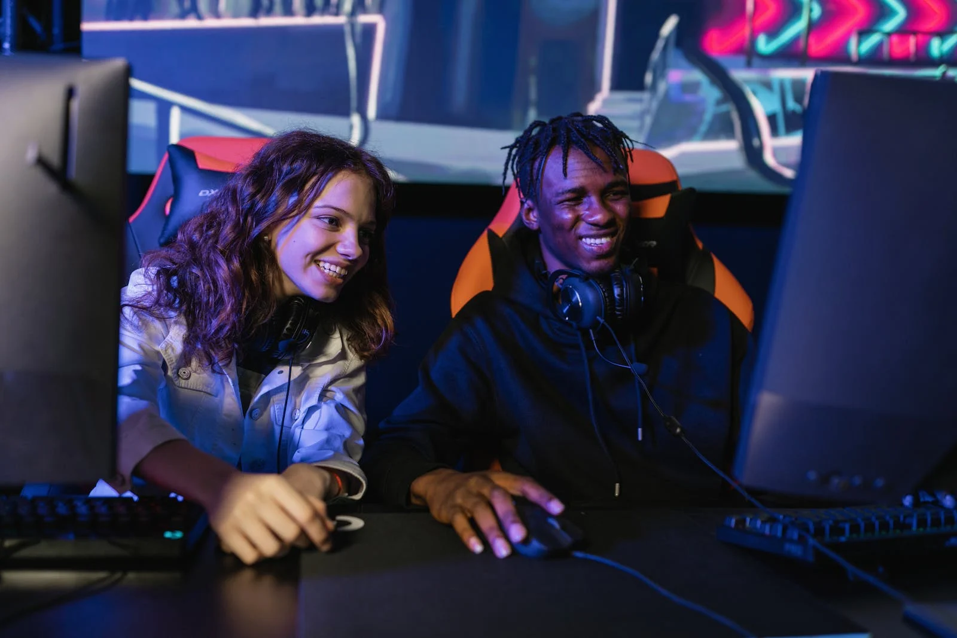
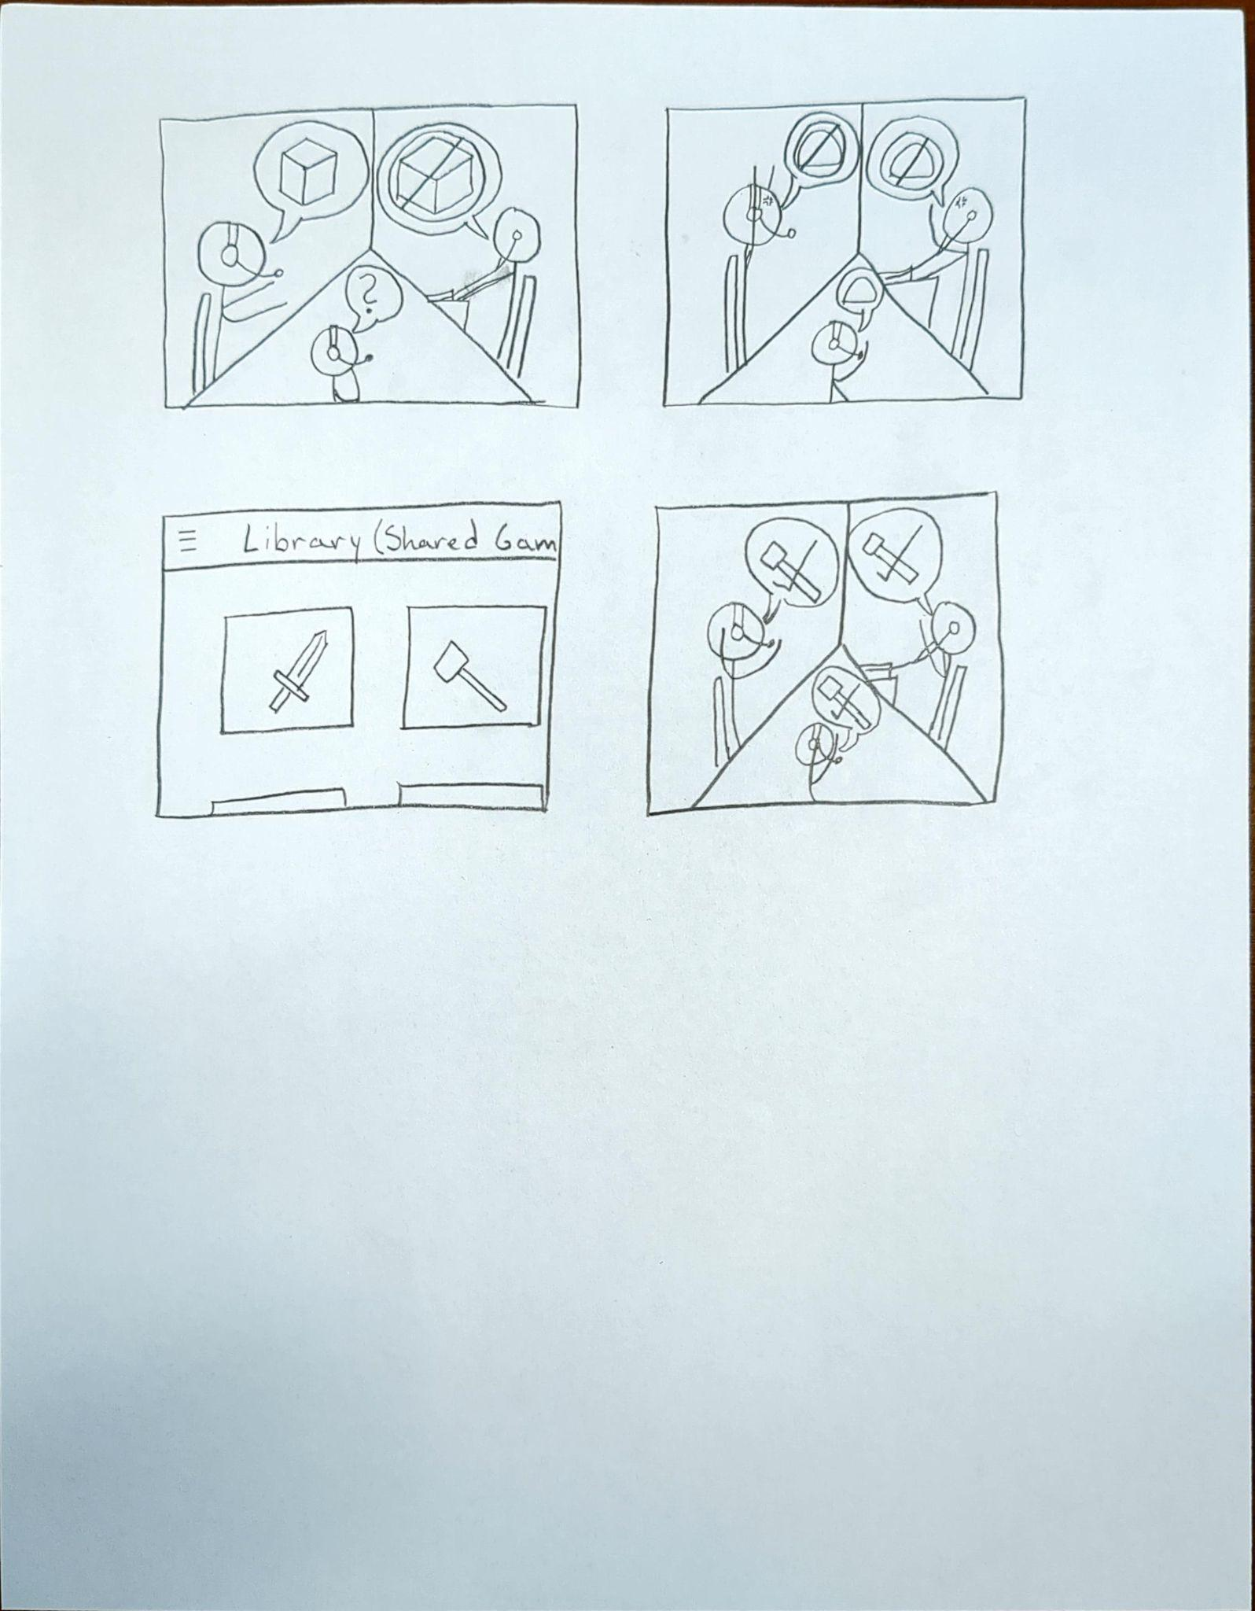
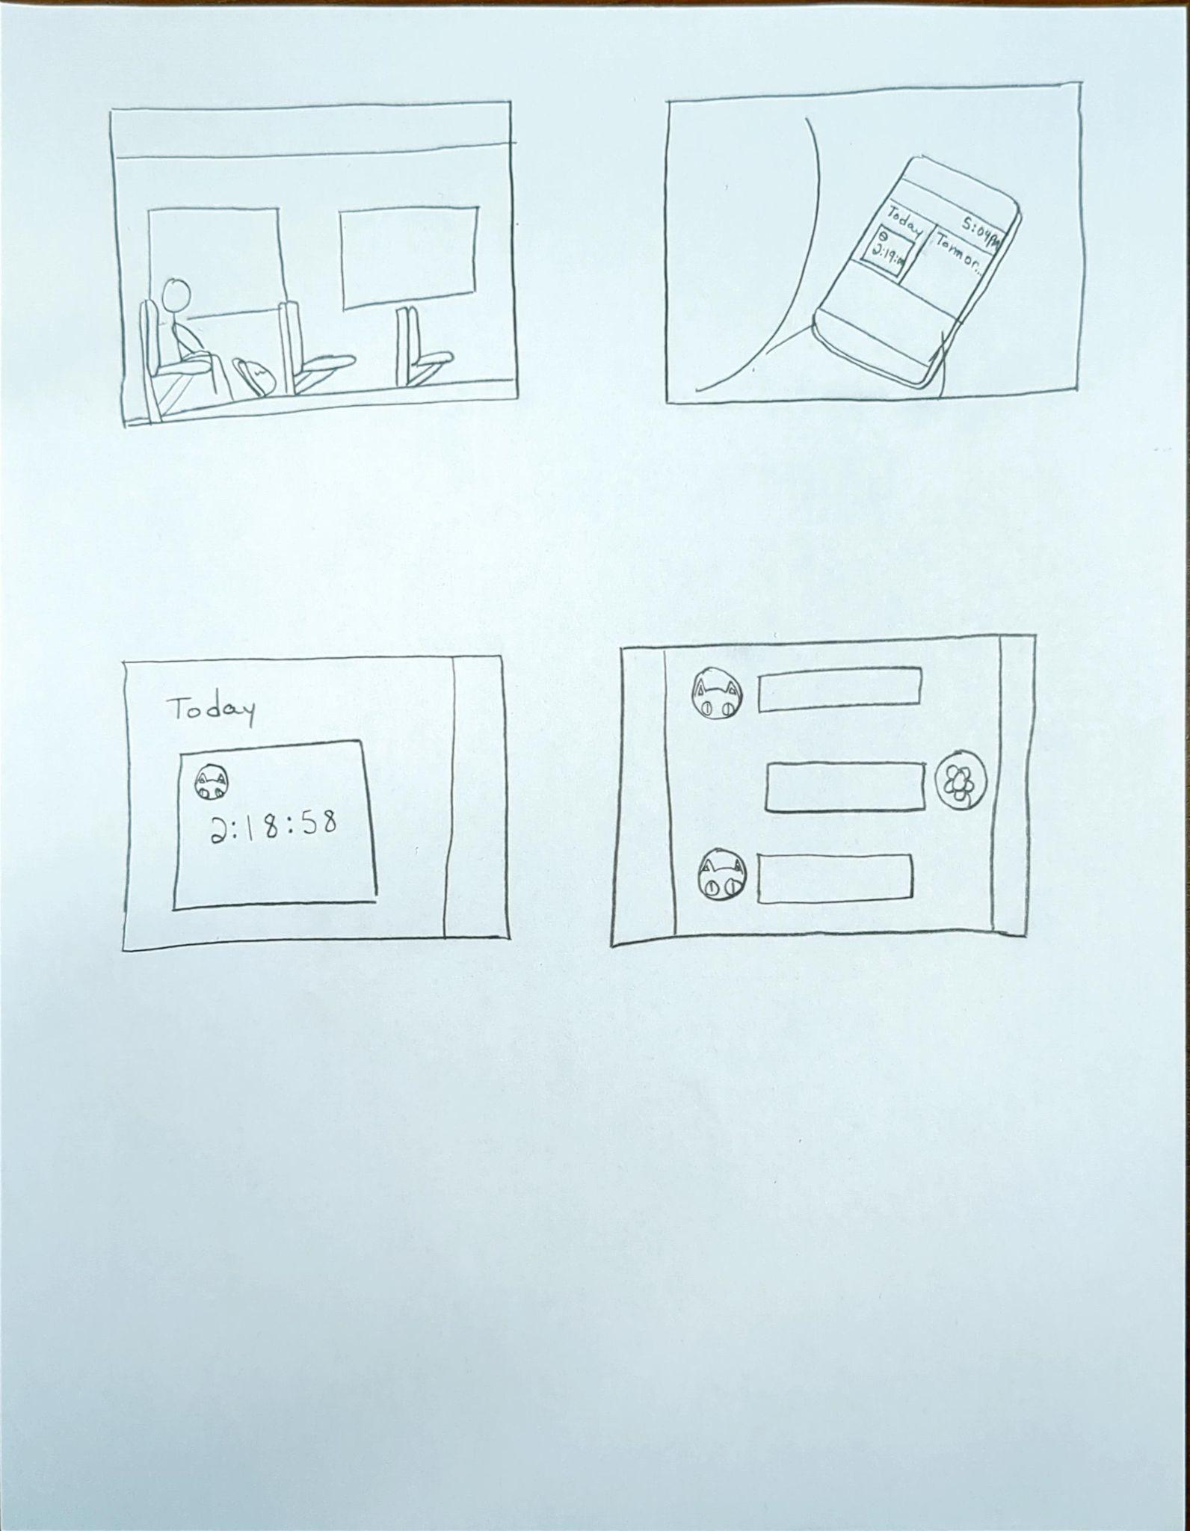
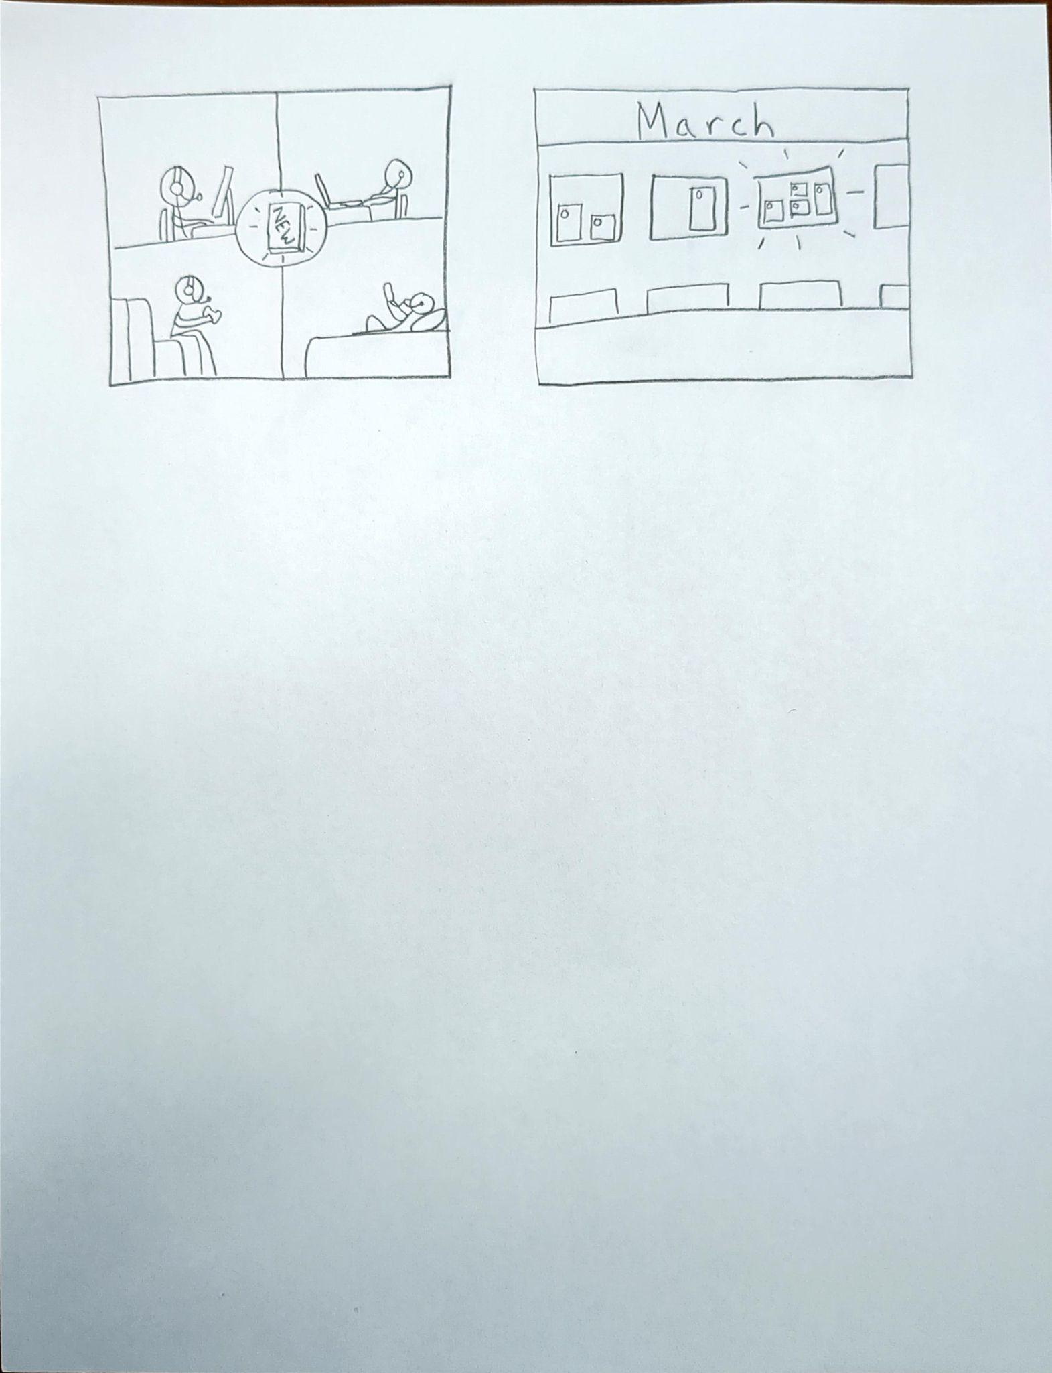
Game-Plan
Group 11
Garrett Abou-Zeid, Bashar Mandily, Zachary Benson, Wil Bishop, Trey Taylor, and Todd Nathan
Topic Motivation:
We found through our user data, gamers can have a hard time playing games with each other due to scheduling conflicts. They also have a hard time deciding what games to play, especially when they been playing the same games for a long time. Our app will try to solve these problems by being able to schedule time slots for when you are playing games and being able to see when your friends are playing games. As well as being able to vote with your friends what games to play, based on the shared games you and your friends have.
Methods & Formative:
Data was collected via interviewing 6 college students who game in their free time. Each interview lasted around 25 min, depending on how the participants answered the questions prepared by the interviewer. In addition, the transcripts for those interviews were recorded for thematic analysis purposes. Key quotes from each transcript were selected by a team member who wasn’t the interviewer of that participant, then they were clustered and then categorized into themes. Themes were then used to analyze the formative work.
Formative Analysis Results:
ALLOWS PEOPLE TO CONNECT WITH THEIR FRIENDS TO PLAY GAMES TOGETHER: Many people prefer to play games with friends, such as one user who said, “I prefer to play with my friends when I play.”
ALLOWS PEOPLE TO COMPARE THEIR SCHEDULES WITH FRIENDS TO FIND TIME FOR GAMING TOGETHER: Many people often want to play with friends but find it difficult to find time they all have free, such as an interview participant who said, “My friends can’t play when I can; either they already fell asleep or they have other things to do.”
ALLOWS PEOPLE TO CHOOSE A GAME THAT THE WHOLE FRIEND GROUP CAN AGREE ON: Often people want to come to consensus before playing a new game with their friends, such as the interview participant who said, “We think about what we play first in terms of like what everyone wants to play.”
ALLOWS PEOPLE TO AUTOMATICALLY SEE WHICH GAMES THEY ALL ALREADY OWN: Our interview participants expressed that they have difficulty finding a game which all of the people in their friend group own a copy of. One participant said, “If I'm looking for a new game to play, I'll look through my Steam library or whatever I have downloaded.” This could be alleviated if they used Game-Plan to automatically suggest games that they and their friends all have.
Selection Process:
We used IDEO ideation to generate ideas for our our app and came up with over a hundred different ideas that fit with the key themes found in our thematic analysis of the user data. From the hundreds of ideas we culled ideas that didn’t fit, combined similar ideas, and then clustered the remaining ideas into a few bigger app ideas, until we had a handful of good ideas. We then took a group vote on what idea, of the remaining list, we felt fit best with our themes and implications. With our final idea selected we refined and completed the feature set of that idea with what we felt best fit the core purpose of our final idea.
Final Idea:
Sarah and their group of friends all play the same multiplayer game and there is a big new update coming out soon. Sarah wants to play this new expansion with her friends, but with everyone having such busy lives Sarah doesn’t know when they all have free time. Luckily Sarah and their friends have the Game-Plan app, so Sarah can go onto the app and check their group’s calendar feature to see what days her friends have marked down some free time. Sarah finds that they all have free time to play the new update together in a few days and messages their friends about it. On Wednesday night Sarah and their friends have a blast playing the new expansion all together for the first time.
Taylor and their group of friends have grown bored of their usual games and want to play something new together. They could spend hours trying to find games that they all own, and that everyone would want to play, but they don't have to because they have the Game-Plan it app. Taylor and their friends look at the shared library tab for their friends, and use the app’s voting feature to quickly find games in common and pick out a new game to play together.
Sam is on their way home and wants to play some video games with their friends, but they don't know if any of their friends are available. They check the Game-Plan app and see that their friend Todd is playing video games right now, and has a lot of free time left to play games. Sam messages Todd and asks them if he can join when he gets home. Todd and Same spend the next two hours having fun playing video games together.

